Slide 1
CS162 Operating Systems and Systems Programming Lecture 1 What is an Operating System?
August 22rd , 2018
Prof. David Culler
http://cs162.eecs.Berkeley.edu

Slide 2
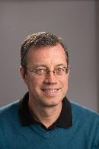
Instructor: Ion Stoica
465 Soda Hall (RISE Lab)
Web: http://www.cs.berkeley.edu/~istoica/
Office hours (tentative):
Mondays 1-2pm, and Thursdays 11-12pm in 465F Soda
Research areas:
ML systems (Ray, Pywren, Clipper, …)
Big Data systems (Apache Spark, Succinct, …)
Previous: Cloud computing (Apache Mesos, Alluxio), Peer-to-Peer networking (Chord), Networking QoS
Notes:
Mesos – Apple, Netflix, Twitter, Yelp, Airbnb, Groupon, Ebay, PayPal
Spark – Amazon, Baidu, Ebay, Groupon,Yahoo!

Slide 3
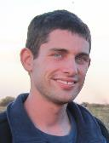
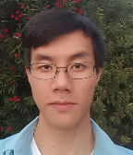

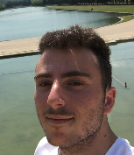
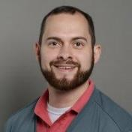
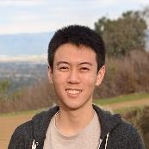
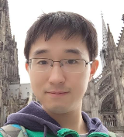
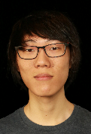
CS162 TAs
Alon Amid
Jason Chin
Eric Hou
Alexander Kozarian
Devin Petersohn
William Sheu
Yang You
Eric Zhou

Slide 4

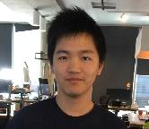
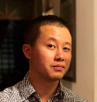

CS162 Readers
Natalia Layson
Michael Luo
Denny Liang
Alexander Wu

Slide 5
This and Next Week
Sections Tuesdays/Wednesdays – attend any section you want
We’ll assign permanent sections after forming project groups
This week will help us determine the section balance
This is an Early Drop Deadline course (September 1)
If you are not serious about taking, please drop early
Dept will continue to admit students as other students drop
On the waitlist ???
Unfortunately, we maxed out sections and this room capacity

Slide 6
Goals for Today
What is an Operating System?
And – what is it not?
What makes Operating Systems so exciting?
Oh, and “How does this class operate?”
Interactive is important!
Ask Questions!
Slides courtesy of David Culler, Anthony D. Joseph, John Kubiatowicz, AJ Shankar, George Necula, Alex Aiken, Eric Brewer, Ras Bodik, Ion Stoica, Doug Tygar, and David Wagner.

Slide 7
What is an operating system?
Special layer of software that provides application software access to hardware resources
Convenient abstraction of complex hardware devices
Protected access to shared resources
Security and authentication
Communication amongst logical entities
appl n
appln
appln
OS
Hardware

Slide 8
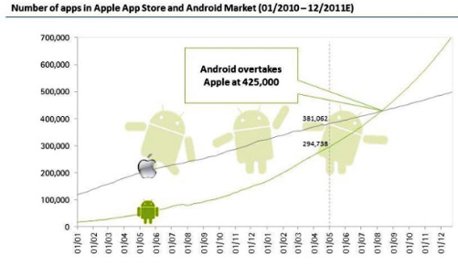
What Does an OS do?
Provide abstractions to apps
File systems
Processes, threads
VM, containers
Naming system
…
Manage resources:
Memory, CPU, storage, …
Achieves the above by implementing specific algos and techniques:
Scheduling
Concurrency
Transactions
Security
…..

Slide 9
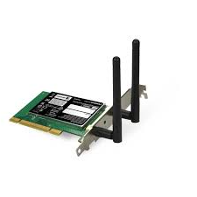
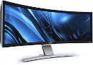

OS Basics: “Virtual Machine” Boundary
Threads
Address Spaces
Windows
Processes
Files
Sockets
Software
OS Hardware Virtualization
Hardware
Instruction Set
Architecture (ISA)
Memory
Processor
Networks
storage
Displays
Inputs

Slide 10
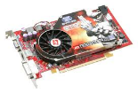
OS Basics: Program => Process
Threads
Address Spaces
Windows
Processes
Files
Sockets
Software
OS Hardware Virtualization
Hardware
ISA
Memory
Processor
OS
storage
Networks
Displays
Inputs

Slide 11
OS Basics: Context Switch
Threads
Address Spaces
Windows
Processes
Files
Sockets
Software
OS Hardware Virtualization
Hardware
ISA
Memory
Processor
OS
storage
Networks
Displays
Inputs

Slide 12
OS Basics: Scheduling, Protection
Threads
Address Spaces
Windows
Processes
Files
Sockets
Software
OS Hardware Virtualization
Hardware
ISA
Memory
Processor
Protection Boundary
OS
storage
Networks
Displays
Inputs

Slide 13
OS Basics: I/O
Threads
Address Spaces
Windows
Processes
Files
Sockets
Software
OS Hardware Virtualization
Hardware
ISA
Memory
Processor
Protection Boundary
OS
Ctrlr
storage
Networks
Displays
Inputs

Slide 14
OS Basics: Loading
Threads
Address Spaces
Windows
Processes
Files
Sockets
Software
OS Hardware Virtualization
Hardware
ISA
Memory
Processor
Protection Boundary
OS
Ctrlr
storage
Networks
Displays
Inputs

Slide 15
What makes Operating Systems Exciting and Challenging?

Slide 16
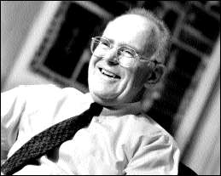
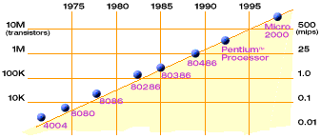
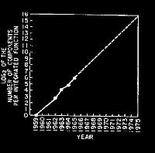
Technology Trends: Moore’s Law
Moore’s Law
2X transistors/Chip Every 1.5 years
Called “Moore’s Law”
Gordon Moore (co-founder of Intel) predicted in 1965 that the transistor density of semiconductor chips would double roughly every 18 months
Microprocessors have become smaller, denser, and more powerful

Slide 17
New Challenge: Slowdown in Joy’s law of Performance
3X
From Hennessy and Patterson, Computer Architecture: A Quantitative Approach, 4th edition, Sept. 15, 2006
⇒ Sea change in chip design: multiple “cores” or processors per chip
VAX : 25%/year 1978 to 1986
RISC + x86 : 52%/year 1986 to 2002
RISC + x86 : ??%/year 2002 to present

Slide 18
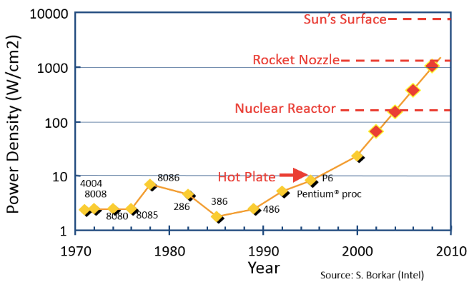
Another Challenge: Power Density
Moore’s law extrapolation
Potential power density reaching amazing levels!
Flip side: battery life very important
Moore’s law can yield more functionality at equivalent (or less) total energy consumption

Slide 19
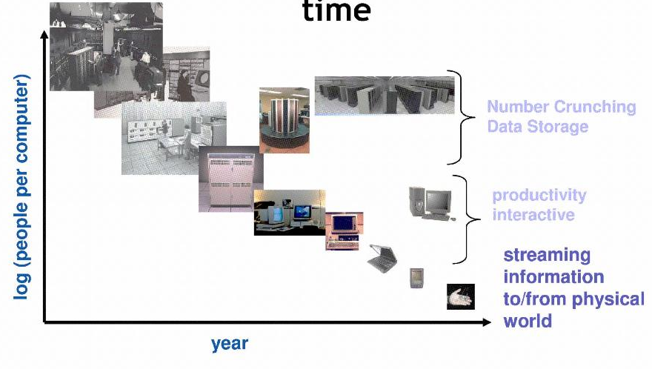
People-to-Computer Ratio Over Time
From David Culler
Today: multiple CPUs/person!
Approaching 100s?

Slide 20
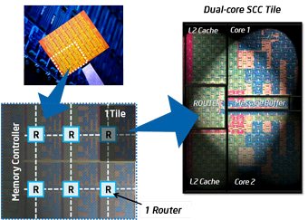
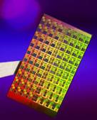
ManyCore Chips: The future is here
Intel 80-core multicore chip (Feb 2007)
80 simple cores
Two FP-engines / core
Mesh-like network
100 million transistors
65nm feature size
Intel Single-Chip Cloud Computer (August 2010)
24 “tiles” with two cores/tile
24-router mesh network
4 DDR3 memory controllers
Hardware support for message-passing
Amazon X1 instances (2016)
128 virtual cores, 2 TB RAM
How to program these?
Use 2 CPUs for video/audio
Use 1 for word processor, 1 for browser
76 for virus checking???
Parallelism must be exploited at all levels

Slide 21
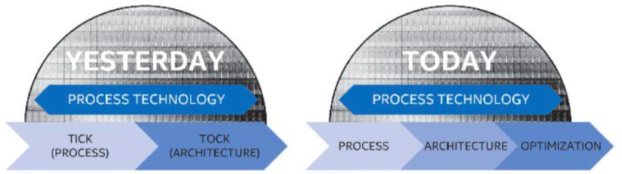
The End of Moore’s Law…
Moore’s Law has (officially) ended -- Feb 2016
No longer getting 2 x transistors/chip every 18 months…
or even every 24 months
May have only 2-3 smallest geometry fabrication plants left:
Intel and Samsung and/or TSMC
Vendors moving to 3D stacked chips
More layers in old geometries
http://files.shareholder.com/downloads/INTC/867590276x0xS50863-16-105/50863/filing.pdf

Slide 22
Storage Capacity
HDD
(source: https://www.networkworld.com/article/3153244/data-center/solid-state-drives-are-now-larger-than-hard-disk-drives-the-impact-for-your-data-center.html)
Notes:
Despite being hurt by Moore’s law as well, the SSD capacity will continue to increase significantly (much faster than CPU computation power) due to the more effective use of 3D layering. So expect more storage capacity per core.

Slide 23
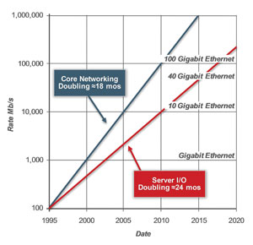
Network Capacity
(source: http://www.ospmag.com/issue/article/Time-Is-Not-Always-On-Our-Side )
Notes:
Networking bandwidth is expected to also outpace the CPU power, so more bandwidth per core.

Slide 24
Challenge: Complexity
Applications consisting of…
… a variety of software modules that …
… run on a variety of devices (machines) that
… implement different hardware architectures
… run competing applications
… fail in unexpected ways
… can be under a variety of attacks
Not feasible to test software for all possible environments and combinations of components and devices
The question is not whether there are bugs but how serious are the bugs!

Slide 25
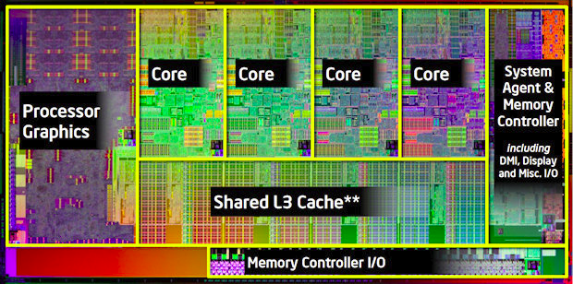
A Modern Processor: Intel Sandy Bridge
Package: LGA 1155
1155 pins
95W design envelope
Cache:
L1: 32K Inst, 32K Data (3 clock access)
L2: 256K (8 clock access)
Shared L3: 3MB – 20MB
Transistor count:
504 Million (2 cores, 3MB L3)
2.27 Billion (8 cores, 20MB L3)
Note that ring bus is on high metal layers – above the Shared L3 Cache

Slide 26
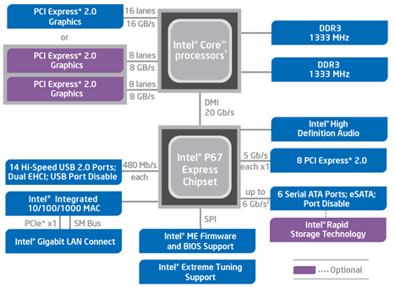
HW Functionality comes with great complexity!
Intel Sandy Bridge I/O
Configuration
Proc
Caches
Busses
adapters
Memory
Controllers
Disks
Displays
Keyboards
I/O Devices:
Networks

Slide 27
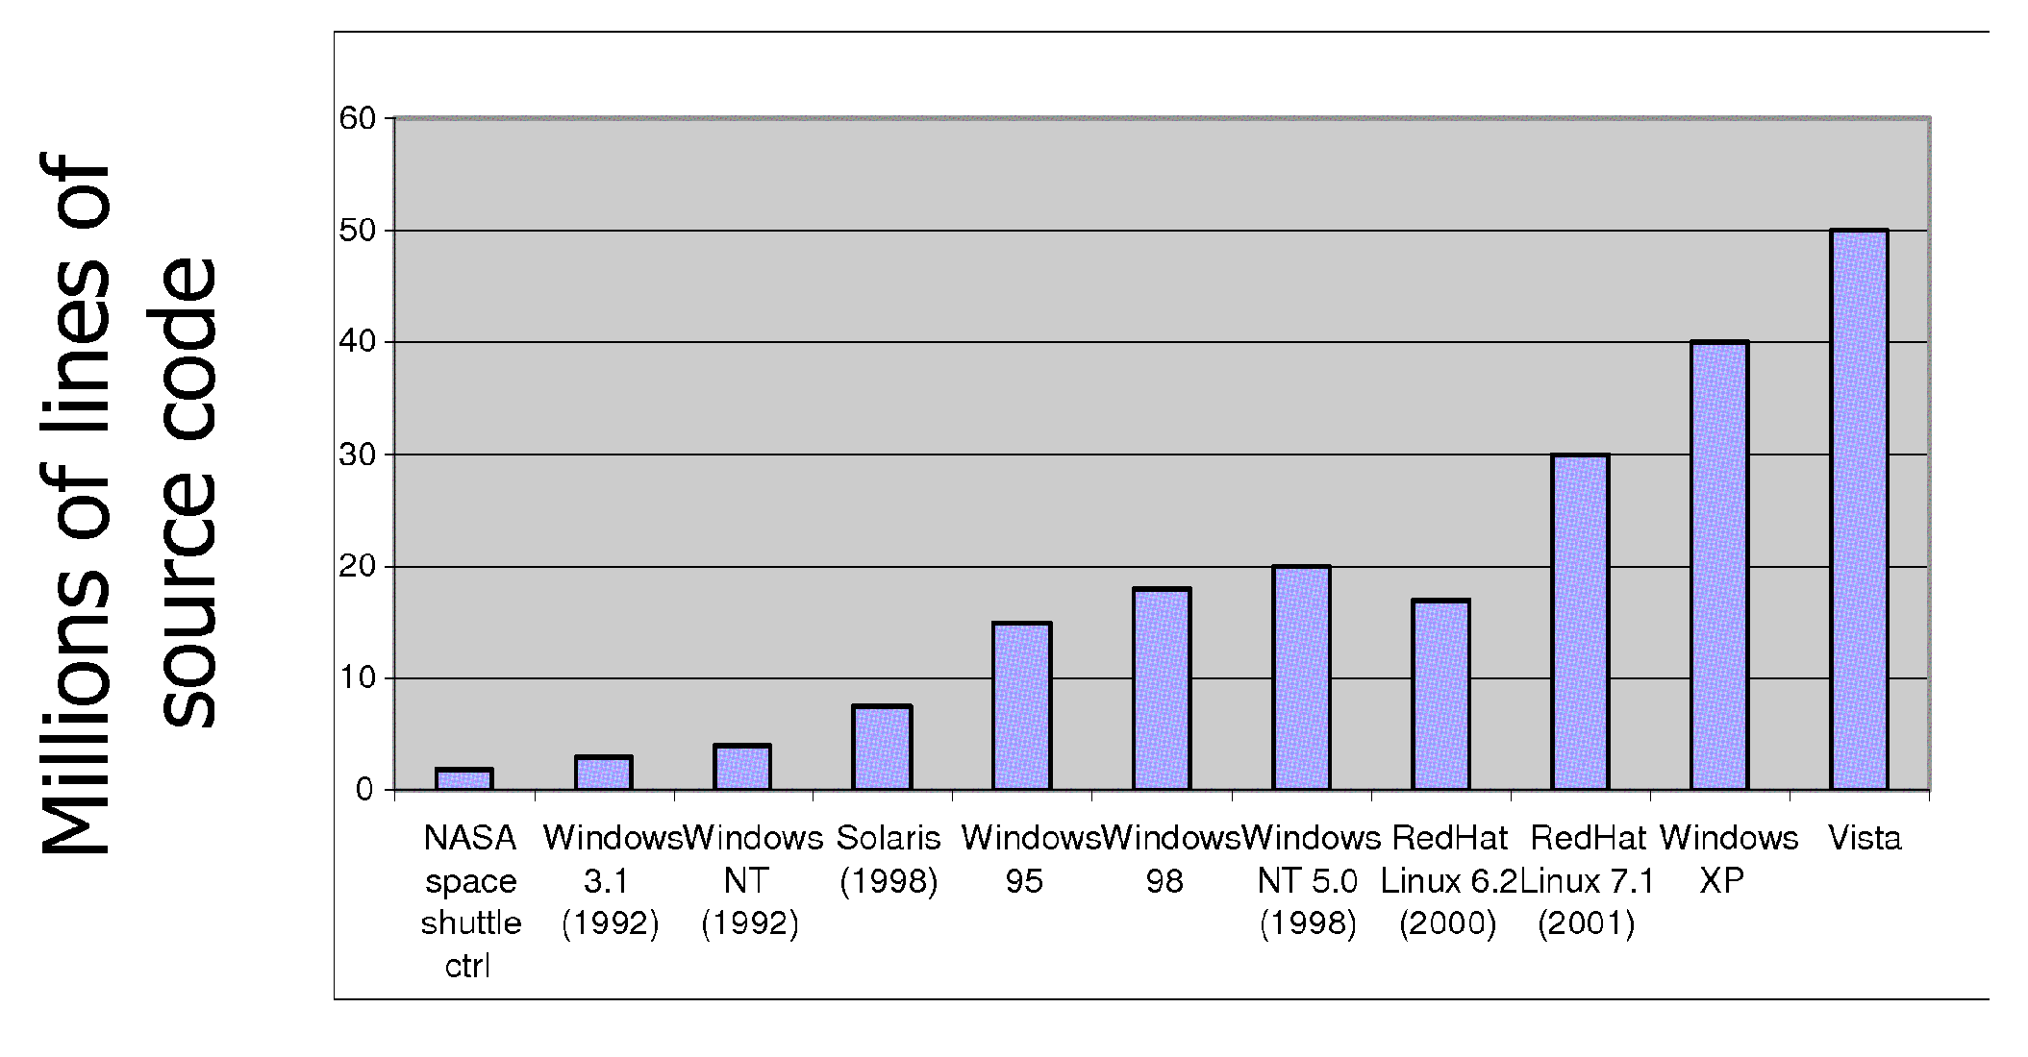
Increasing Software Complexity
From MIT’s 6.033 course

Slide 28
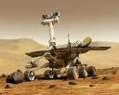
Example: Some Mars Rover (“Pathfinder”) Requirements
Pathfinder hardware limitations/complexity:
20Mhz processor, 128MB of DRAM, VxWorks OS
cameras, scientific instruments, batteries, solar panels, and locomotion equipment
Many independent processes work together
Can’t hit reset button very easily!
Must reboot itself if necessary
Must always be able to receive commands from Earth
Individual Programs must not interfere
Suppose the MUT (Martian Universal Translator Module) buggy
Better not crash antenna positioning software!
Further, all software may crash occasionally
Automatic restart with diagnostics sent to Earth
Periodic checkpoint of results saved?
Certain functions time critical:
Need to stop before hitting something
Must track orbit of Earth for communication
A lot of similarity with the Internet of Things?
Complexity, QoS, Inaccessbility, Power limitations … ?
Notes:
Distance 186 light secs to 21 light minutes one-way
Nearly two earth years

Slide 29
How do we tame complexity?
Every piece of computer hardware different
Different CPU
Pentium, PowerPC, ColdFire, ARM, MIPS
Different amounts of memory, disk, …
Different types of devices
Mice, Keyboards, Sensors, Cameras, Fingerprint readers
Different networking environment
Cable, DSL, Wireless, Firewalls,…
Questions:
Does the programmer need to write a single program that performs many independent activities?
Does every program have to be altered for every piece of hardware?
Does a faulty program crash everything?
Does every program have access to all hardware?

Slide 30
OS Tool: Virtual Machine Abstraction
Application
Operating System
Hardware
Virtual Machine Interface
Physical Machine Interface
Software Engineering Problem:
Turn hardware/software quirks ⇒ what programmers want/need
Optimize for convenience, utilization, security, reliability, etc…
For any OS area (e.g. file systems, virtual memory, networking, scheduling):
What’s the hardware interface? (physical reality)
What’s the application interface? (nicer abstraction)

Slide 31
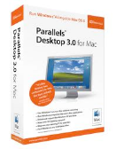
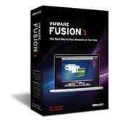
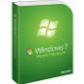
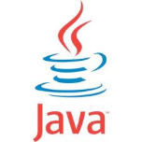
Virtual Machines
Software emulation of an abstract machine
Give programs illusion they own the machine
Make it look like hardware has features you want
Two types of “Virtual Machine”s
Process VM: supports the execution of a single program; this functionality typically provided by OS
System VM: supports the execution of an entire OS and its applications (e.g., VMWare Fusion, Virtual box, Parallels Desktop, Xen)

Slide 32
Process VMs
Programming simplicity
Each process thinks it has all memory/CPU time
Each process thinks it owns all devices
Different devices appear to have same high level interface
Device interfaces more powerful than raw hardware
Bitmapped display ⇒ windowing system
Ethernet card ⇒ reliable, ordered, networking (TCP/IP)
Fault Isolation
Processes unable to directly impact other processes
Bugs cannot crash whole machine
Protection and Portability
Java interface safe and stable across many platforms

Slide 33
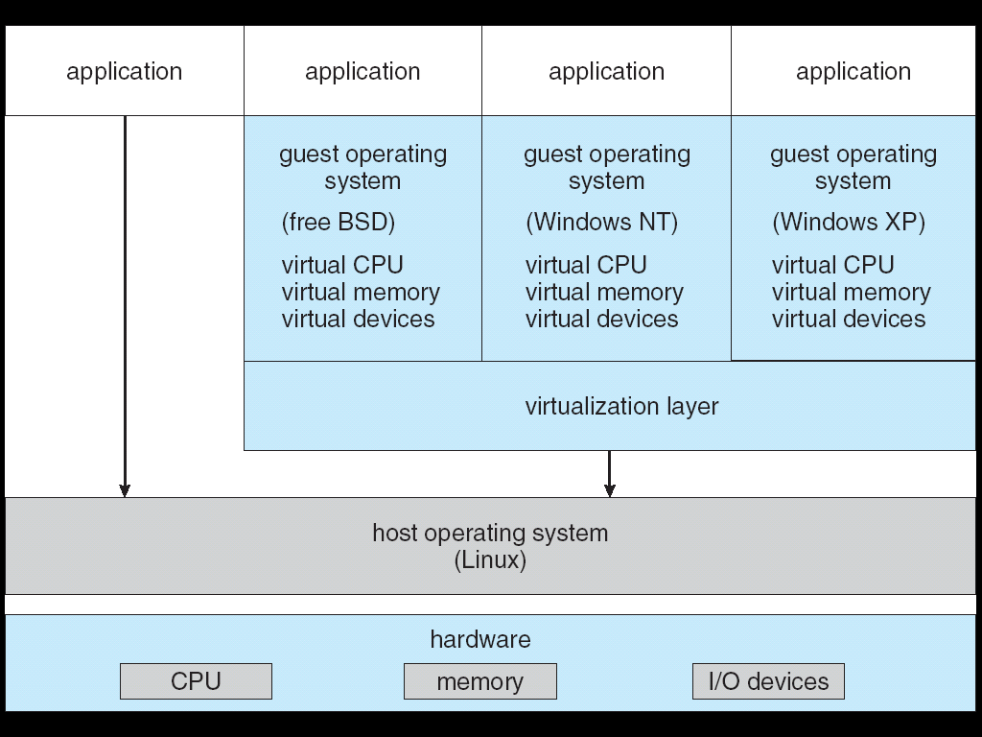
System Virtual Machines: Layers of OSs
Useful for OS development
When OS crashes, restricted to one VM
Can aid testing programs on other OSs

Slide 34
5 min break

Slide 35
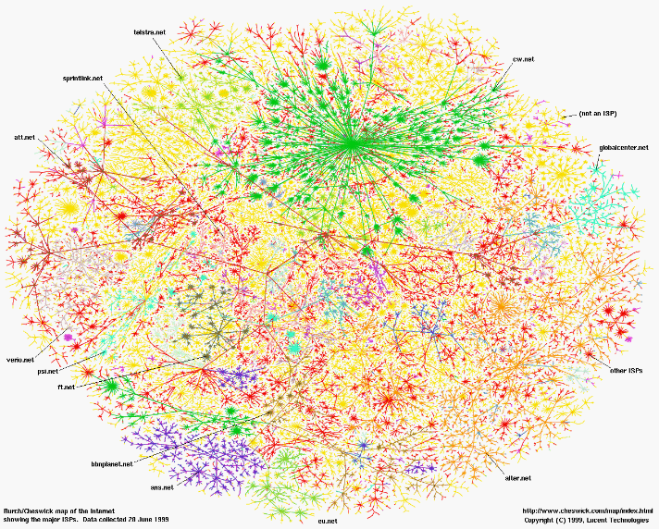
Greatest Artifact of Human Civilization…

Slide 36

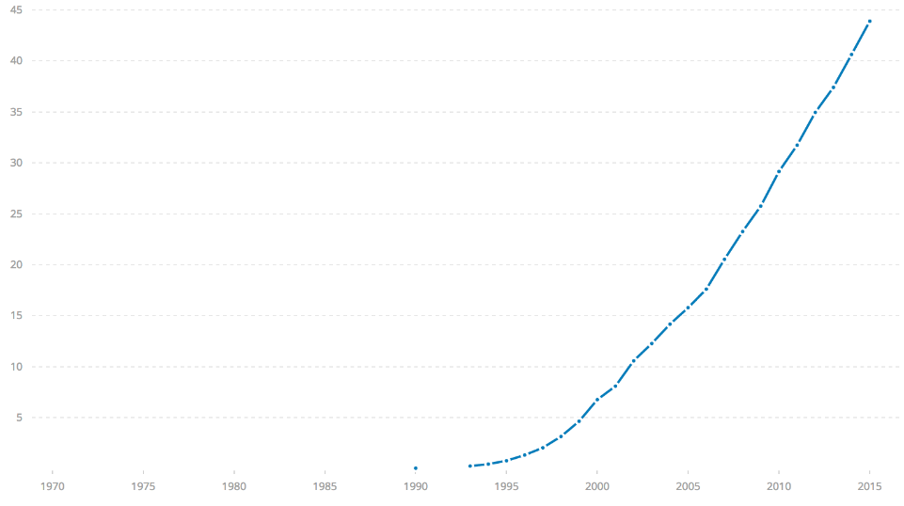

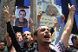
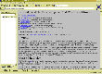
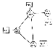
Internet Scale: Over 3.8 Billion Users!
% of world’s
population
3.8 B
ARPANet
Internet
WWW
2.0 B 1/26/11
RFC 675 TCP/IP
HTTP 0.9
1969
1974
1990
2017

Slide 37
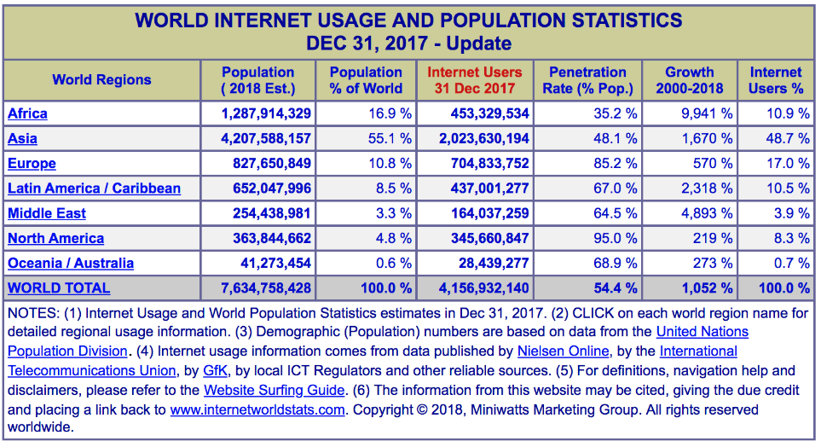
Internet Scale: Over 3.8 Billion Users!
(source: http://www.internetworldstats.com/stats.htm)

Slide 38
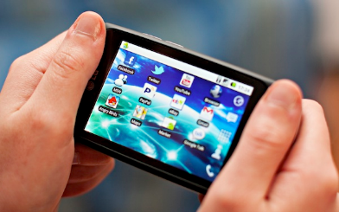
Not Only PCs connected to the Internet
Smartphone shipments exceed PC shipments!
2011 shipments:
487M smartphones
414M PC clients
210M notebooks
112M desktops
63M tablets
25M smart TVs
4 billion phones in the world → smartphone over next decade
1.53B in 2017
262.5M in 2017
164M in 2017
39.5M in 2017

Slide 39
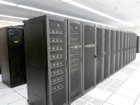
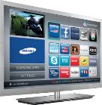
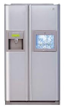
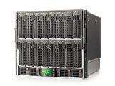
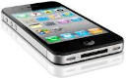
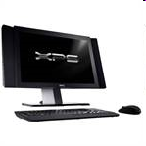
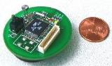
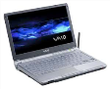
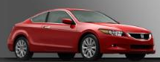
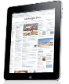
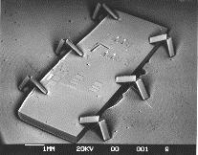

Societal Scale Information Systems (Or the “Internet of Things”?)
Massive Cluster
The world is a large distributed system
Microprocessors in everything
Vast infrastructure behind them
Gigabit Ethernet
Clusters
Massive Cluster
Clusters
Gigabit Ethernet
Internet Connectivity
Scalable, Reliable,
Secure Services
Databases
Information Collection
Remote Storage
Online Games
Commerce
…
MEMS for
Sensor Nets
Notes:
Of the enormous variety of CITRIS projects going on at Berkeley, I will present one set that is tied together by this picture: the design, construction and use of MEMS devices, the sensor networks containing them, and making the information from these networks available to widely distributed users as scalable, reliable and secure services.
The name we give to such an integrated system is a Societal Scale Information System, a name meant to evoke its scale – enormous - and purpose – benefiting people and the economy.
I will leave the details of all the specific applications that Ruzena mentioned, be it to energy efficiency or education or disaster response the social sciences, and indeed most details, to later talks and posters.

Slide 40





Example: What’s in a Search Query?
DNS
Servers
Datacenter
DNS
request
create
result
page
Search
Index
Page store
Load
balancer
Ad Server
Complex interaction of multiple components in multiple administrative domains
Systems, services, protocols, …
Notes:
In this course we are not focusing on a single node system but on the end-to-end system. The reason is very simple: today the majority of applications we use does not run on our system. Social networks, e-mail, google docs, online gamming, etc.

Slide 41


Infrastructure, Textbook & Readings
Infrastructure
Website: http://cs162.eecs.berkeley.edu
Piazza: https://piazza.com/berkeley/fall2018/cs162
Webcast: Cal Central - https://calcentral.berkeley.edu/academics/teaching-semester/fall-2018/class/compsci-162
Textbook: Operating Systems: Principles and Practice (2nd Edition) Anderson and Dahlin
Recommend: Operating Systems Concepts, 9th Edition Silbershatz, Galvin, Gagne
Copies in Bechtel
Online supplements
See course website
Includes Appendices, sample problems, etc.
Networking, Databases, Software Eng, Security
Some Research Papers!

Slide 42
Syllabus
OS Concepts: How to Navigate as a Systems Programmer!
Process, I/O, Networks and Virtual Machines
Concurrency
Threads, scheduling, locks, deadlock, scalability, fairness
Address Space
Virtual memory, address translation, protection, sharing
File Systems
I/O devices, file objects, storage, naming, caching, performance, paging, transactions, databases
Distributed Systems
Protocols, N-Tiers, RPC, NFS, DHTs, Consistency, Scalability, multicast
Reliability & Security
Fault tolerance, protection, security
Cloud Infrastructure

Slide 43
Learning by Doing
Individual Homeworks: Learn Systems Programming
0. Tools, Autograding, recall C, executable
1. Simple Shell
2. Web server
3. Memory allocation
Three Group Projects (Pintos in C)
1. Threads & Scheduling
2. User-programs
3. File Systems

Slide 44
Group Project Simulates Industrial Environment
Project teams have 4 members (try really hard to find 4 members – 3 members requires serious justification)
Must work in groups in “the real world”
Same section much preferred
Communicate with colleagues (team members)
Communication problems are natural
What have you done?
What answers you need from others?
You must document your work!!!
Communicate with supervisor (TAs)
What is the team’s plan?
What is each member’s responsibility?
Short progress reports are required
Design Documents: High-level description for a manager!

Slide 45
Getting started
Start homework 0, this Monday, 9/3
Github account
Registration survey
Vagrant virtualbox – VM environment for the course
Consistent, managed environment on your machine
Get familiar with all the cs162 tools
Submit to autograder via git
Start forming a project group

Slide 46
Grading
42% three midterms (14% each)
Thursday, 9/26, 5-7pm (no class)
Monday, 10/29, 5-7pm (no class)
Wednesday, 11/28, 5-7pm (no class)
35% projects
15% homework
8% participation
No final exam
Projects
Initial design document, Design review, Code, Final design
Submission via git push triggers autograder

Slide 47
Personal Integrity
UCB Academic Honor Code: "As a member of the UC Berkeley community, I act with honesty, integrity, and respect for others."
http://asuc.org/honorcode/resources/HC%20Guide%20for%20Syllabi.pdf

Slide 48


CS 162 Collaboration Policy
Explaining a concept to someone in another group
Discussing algorithms/testing strategies with other groups
Helping debug someone else’s code (in another group)
Searching online for generic algorithms (e.g., hash table)
Sharing code or test cases with another group
Copying OR reading another group’s code or test cases
Copying OR reading online code or test cases from prior years
We compare all project submissions against prior year submissions and online solutions and will take actions (described on the course overview page) against offenders

Slide 49
Lecture Goal
Interactive!!!

Slide 50



What is an Operating System?
Referee
Manage sharing of resources, Protection, Isolation
Resource allocation, isolation, communication
Illusionist
Provide clean, easy to use abstractions of physical resources
Infinite memory, dedicated machine
Higher level objects: files, users, messages
Masking limitations, virtualization
Glue
Common services
Storage, Window system, Networking
Sharing, Authorization
Look and feel

Slide 51
What is an Operating System,… Really?
Most Likely:
Memory Management
I/O Management
CPU Scheduling
Communications? (Does Email belong in OS?)
Multitasking/multiprogramming?
What about?
File System?
Multimedia Support?
User Interface?
Internet Browser? ☺
Is this only interesting to Academics??

Slide 52
Operating System Definition (Cont.)
No universally accepted definition
“Everything a vendor ships when you order an operating system” is good approximation
But varies wildly
“The one program running at all times on the computer” is the kernel
Everything else is either a system program (ships with the operating system) or an application program

Slide 53
“In conclusion…”
Operating systems provide a virtual machine abstraction to handle diverse hardware
Operating systems simplify application development by providing standard services
Operating systems coordinate resources and protect users from each other
Operating systems can provide an array of fault containment, fault tolerance, and fault recovery
CS162 combines things from many other areas of computer science:
Languages, data structures, hardware, and algorithms

